Slide 1



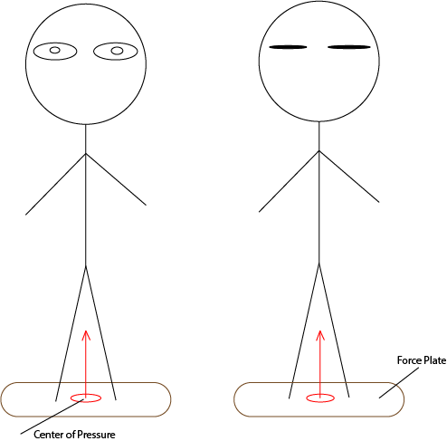
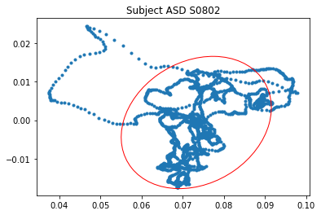
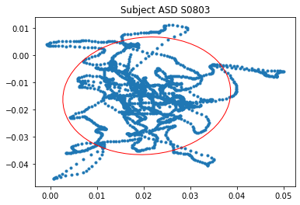
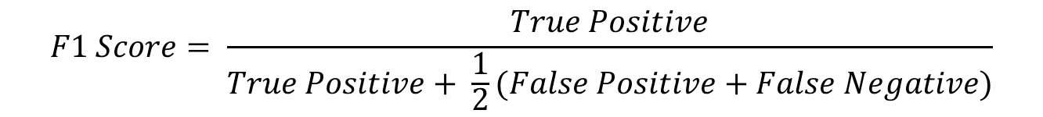

Enhancing Early Diagnosis of Autism with Machine Learning Algorithms Using Postural Control Features
Hayden Cressman
Mentor: Yumeng Li, Ph.D.
Abstract
Methods
Results
Autism Spectrum Disorder (ASD) is known to cause deficits in motor functionality and stability when compared to children of Typical Development (TD). The cause of this is still under research, but it is quantifiable and usable for classification.^{[1]}
In total there were 40 TD subject trials and 36 ASD subject trials. 7 features of COP were used in the machine learning classifiers.
Displacement in the Mediolateral and Anteroposterior Directions
Area of Postural Sway
Multiscale Entropy in the Mediolateral and Anteroposterior Directions
Complexity Index based off the Multiscale Entropy
The classification performance of each learning algorithm can be seen below, denoted by an overall F1 quality score.
Eyes Open
Eyes Closed
Eyes Open Center of Pressure Data
Eyes Closed Center of Pressure Data
Figure 4. The F1 bar graph for all 7 classification models.
$$F1 Score= \frac{True Positive}{True Positive+ \frac{1}{2}(False Positive+False Negative)}$$
[2]
Figure 2. The Center of Pressure data acquired from one subject during eyes open and eyes closed with an elliptical 95% confidence area shown in red.
Table 1. The confusion matrices for the classification models. In this case ASD refers to Positive and TD refers to Negative when in relation to the F1score.
Predicted Values
 | K-Nearest Neighbor |  | Logistic Regression |  | Decision Tree |  | Naïve Bayes |  | Random Forest |  | Discriminant Analysis |  | SVM
 | ASD | TD | ASD | TD | ASD | TD | ASD | TD | ASD | TD | ASD | TD | ASD | TD
ASD | 8 | 4 | 11 | 1 | 11 | 1 | 6 | 6 | 11 | 1 | 10 | 2 | 11 | 1
TD | 2 | 9 | 2 | 9 | 1 | 10 | 3 | 8 | 1 | 10 | 2 | 9 | 3 | 8
Actual Values
Figure 1. Drawing of an individual test with the center of pressure, force plate, and eyes open and closed tests presented.
Conclusion and Future Work
Through the classifiers used we can see that some are able to outperform others, however overall, their ability to distinguish between ASD and TD subjects is high given the small sample size. Some key factors to modify in the future include:
Larger sample sizes
Modified attribute weights
Better standardization of acquired data
Inclusion of more classifier models
Purpose
Figure 3. The Sample Entropy for TD and ASD subjects average over both the mediolateral and anteroposterior directions for six time-scales.
There currently exists no direct clinical test for diagnosis of Autism Spectrum Disorder.
Using machine learning and classification models we can assist in the early diagnosis of autism through center of pressure (COP) data
7 supervised machine learning algorithms were used to analyze the features and make classifications (70% training and 30% testing sets):
K-Nearest Neighbors
Logistic Regression
Decision Tree
Multinominal Naïve Bayes
Random Forest
Linear Discriminant Analysis
Support Vector Machine
Acknowledgments
This research is funded by the National Science Foundation under award 2150135 and hosted by Texas State University.
References:
Melissa A. Mache, Teri A. Todd (2016), Gross motor skills are related to postural stability and age in children with autism spectrum disorder, Research in Autism Spectrum Disorders, Volume 23, 2016, Pages 179-187
Y. Sasaki, The truth of the F-measure (2007), https://www.cs.odu.edu/~mukka/cs795sum09dm/Lecturenotes/Day3/F-measure-YS-26Oct07.pdf

